Slide 1
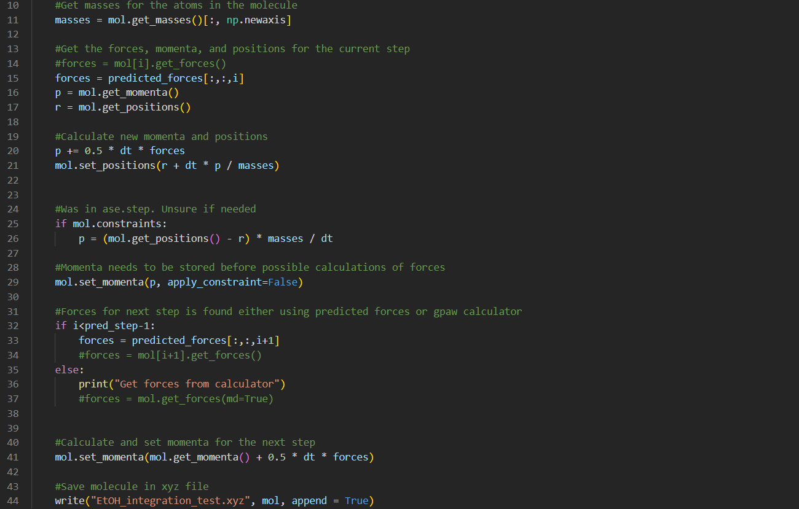

Slide 2
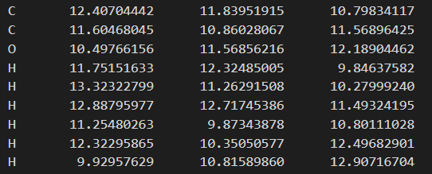
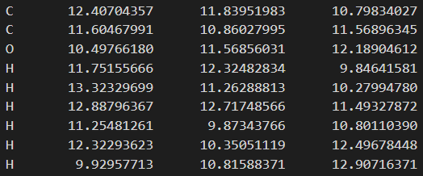
Calculating momenta and positions with predicted forces (1st prediction)
Simulation
Calculation

Slide 3
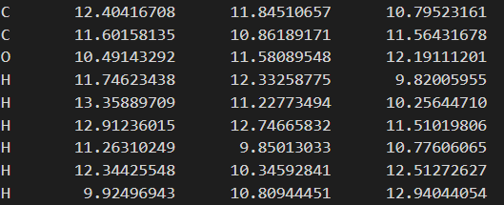
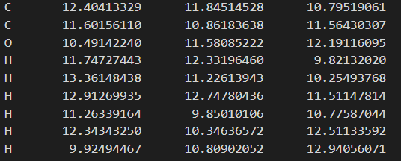
Calculating momenta and positions with predicted forces (3rd prediction)
Simulation
Calculation

Slide 4




Slide 5
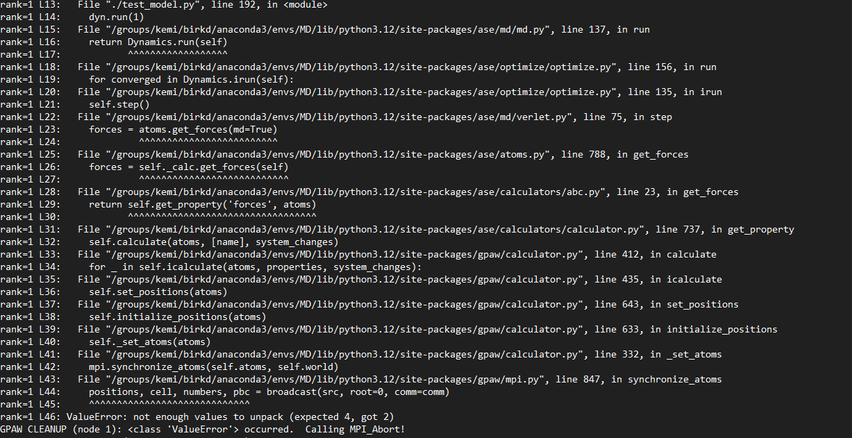

Slide 8
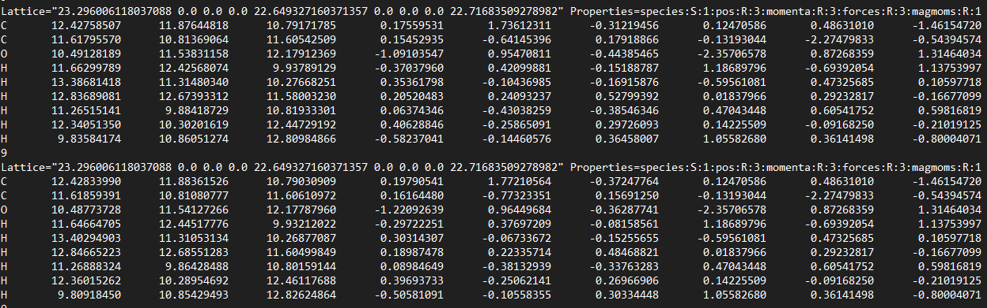
Forces does not get updated
Positions
Momenta
Forces
Simulated step
Predicted step

Slide 9
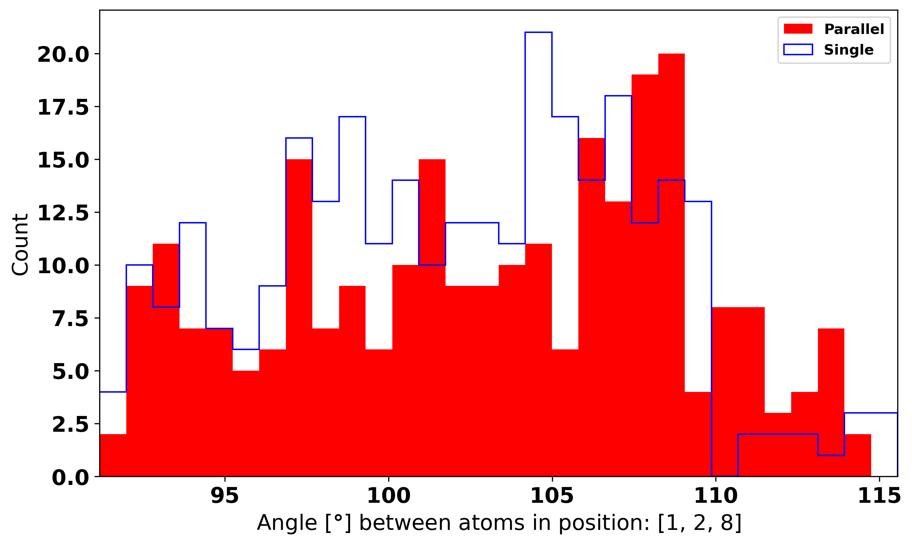
Histogram of angle

Slide 10
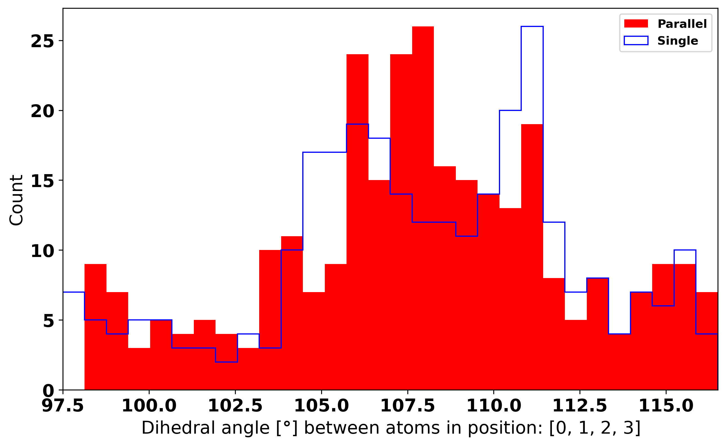
Histogram of dihedral angle

Slide 11
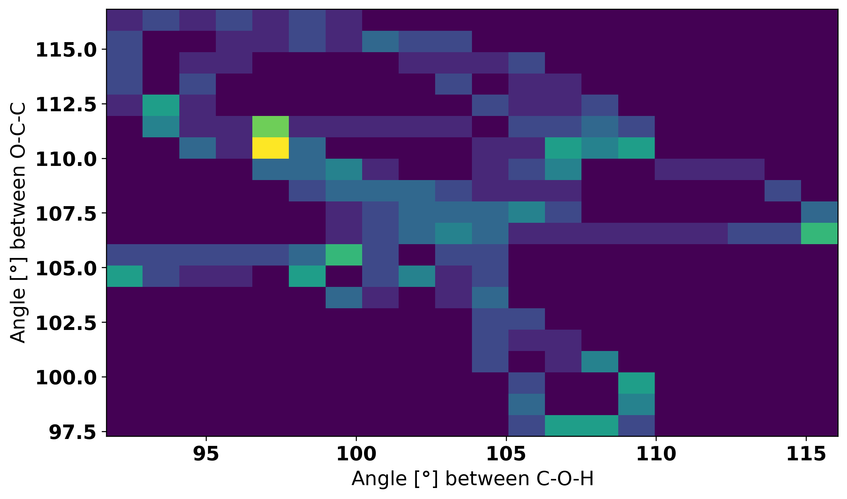
2D Histogram of angle

Slide 12
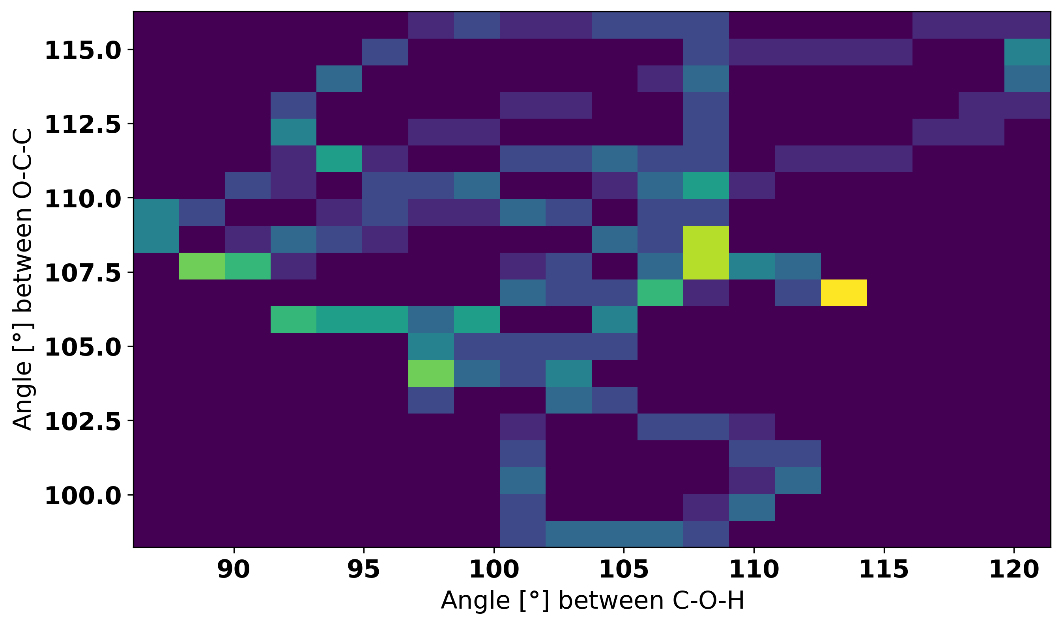
2D Histogram of angle

Slide 13
Need more data (time steps)?
Compare the similarity of histograms
Chi2 or Kolmogorov–Smirnov
Compare average values
Fit a Gaussian using chi2
Find the average and variance of the data set

